Slide 1
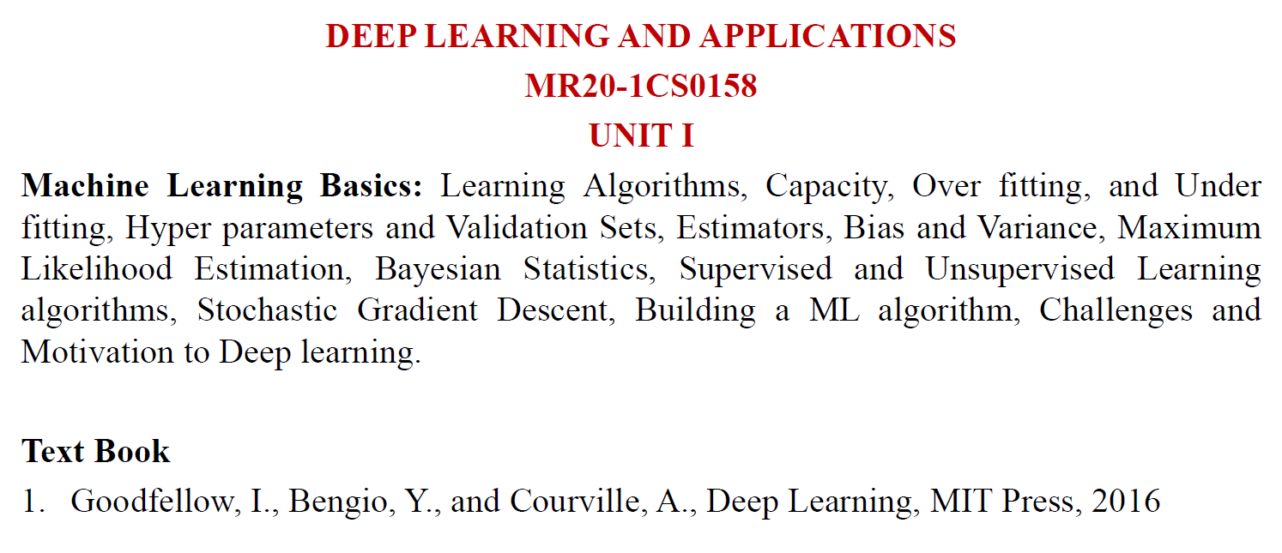

Slide 2
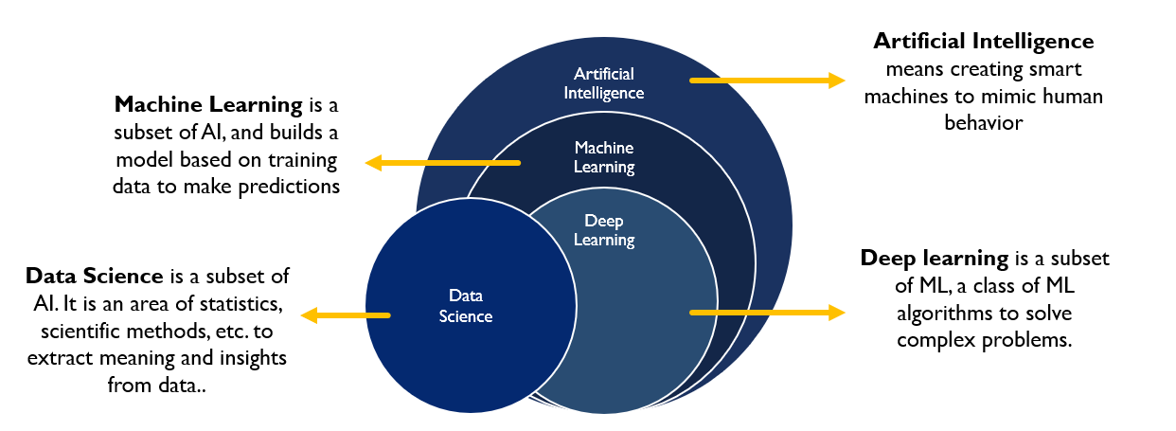
Deep learning is a specific kind of machine learning.
In order to understand deep learning well, one must have a solid understanding of the basic principles of machine learning.

Slide 3
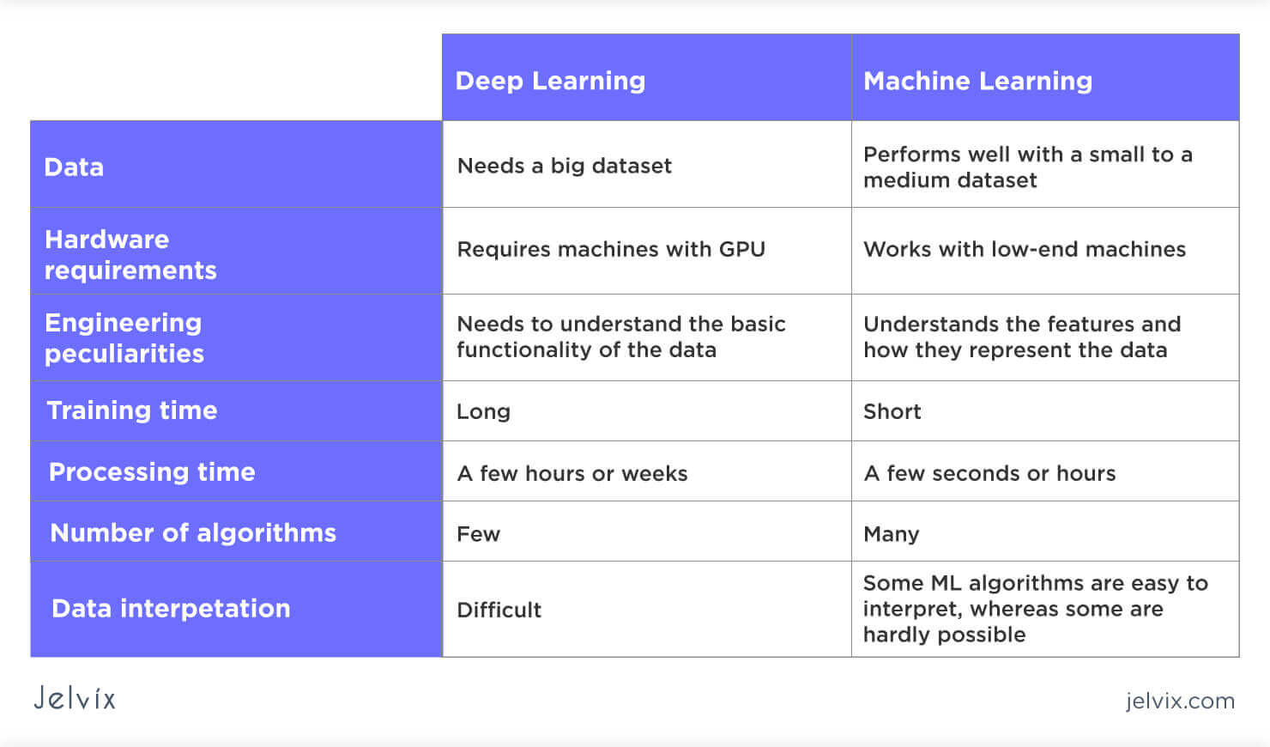

Slide 4
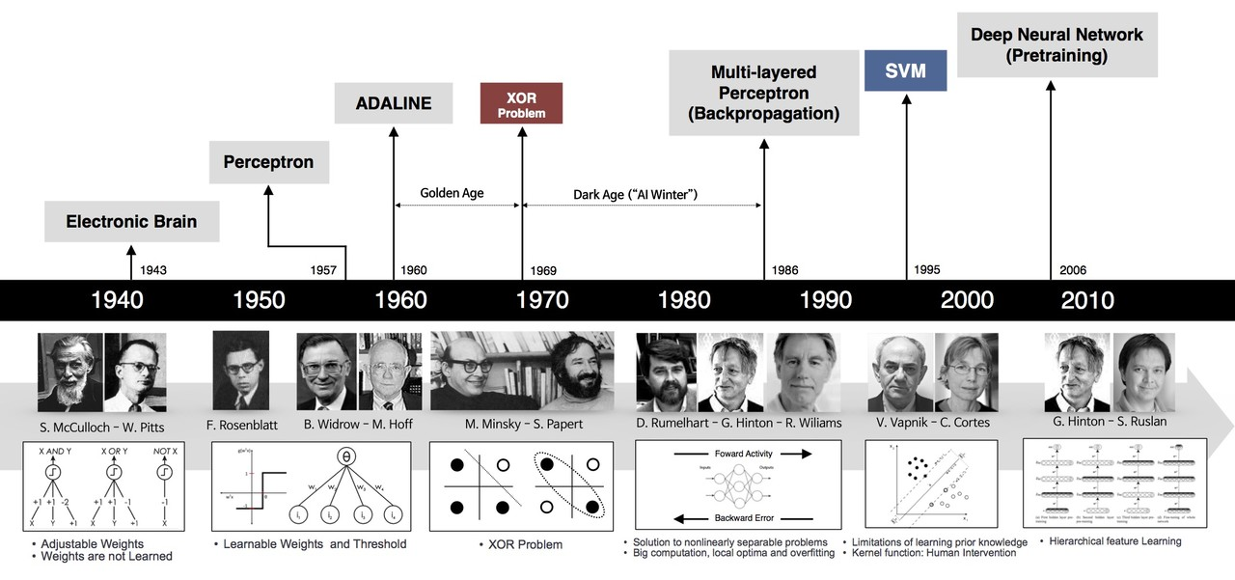

Slide 5
perCNN & RNN ceptron, a single-layer neural network introduced in the 1950s. only solve linearly separable problems
Multi-Layer Perceptrons (MLPs), It introduced hidden layers and non-linear activation functions. uses backpropagation could model complex, non-linear relationships
CNN & RNN CNNs (Convolutional Neural Networks) and RNNs (Recurrent Neural Networks) are both types of neural networks, but they are designed for different types of data and tasks. CNNs are primarily used for processing spatial data, like images, while RNNs excel at handling sequential data, such as text or time series.

Slide 6
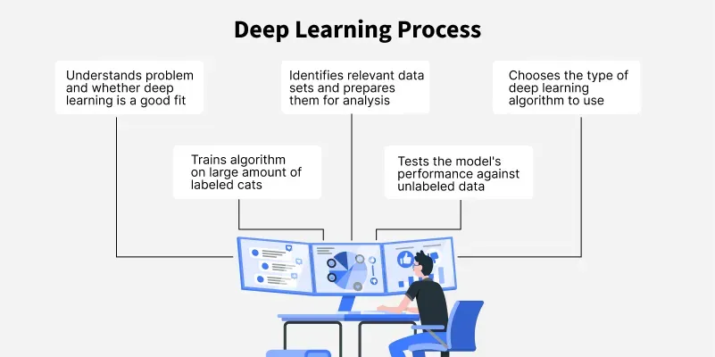
Deep Learning is transforming the way machines understand, learn and interact with complex data. Deep learning mimics neural networks of the human brain, it enables computers to autonomously uncover patterns and make informed decisions from vast amounts of unstructured data

Slide 7
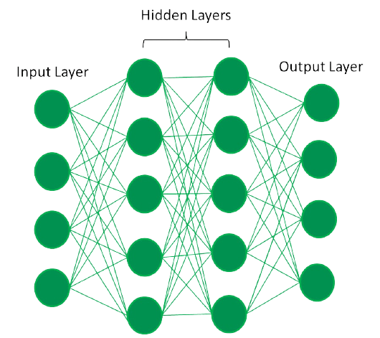
In a deep neural network the input layer receives data which passes through hidden layers that transform the data using nonlinear functions. The final output layer generates the model’s prediction.

Slide 8
TYPES of NEURAL NETWORKS
Feedforward neural networks (FNNs) are the simplest type of ANN, data flows in one direction from input to output. used for basic tasks like classification.
Convolutional Neural Networks (CNNs) are specialized for processing grid-like data, such as images. CNNs use convolutional layers to detect spatial hierarchies, making them ideal for computer vision tasks.
Recurrent Neural Networks (RNNs) are able to process sequential data, such as time series and natural language. RNNs have loops to retain information over time, enabling applications like language modeling and speech recognition.
Generative Adversarial Networks (GANs) consist of two networks—a generator and a discriminator—that compete to create realistic data. GANs are widely used for image generation, style transfer and data augmentation.
Autoencoders are unsupervised networks that learn efficient data encodings. They compress input data into a latent representation and reconstruct it, useful for dimensionality reduction and anomaly detection.
Transformer Networks has revolutionized NLP with self-attention mechanisms. Transformers excel at tasks like translation, text generation and sentiment analysis, powering models like GPT and BERT.

Slide 9
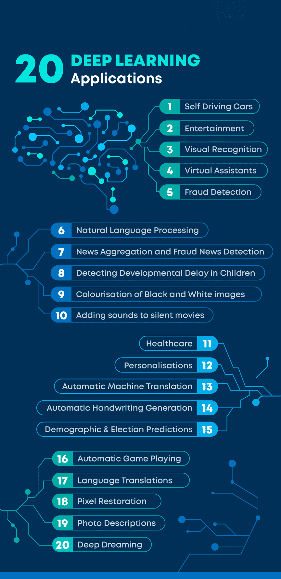

Slide 10
Learning Algorithms

Slide 11
A machine learning algorithm is an algorithm that is able to learn from data
Learning definition as given by Mitchell (1997)
“A computer program is said to learn from experience E with respect to some class of tasks T and performance measure P, if its performance at tasks in T, as measured by P, improves with experience E.”
The Task, T
Machine learning allows us to tackle tasks that are too difficult to solve with fixed programs written and designed by human beings
Machine learning tasks are usually described in terms of how the machine learning system should process an example.
An example /
data points.
is a collection of features that have been quantitatively measured from some object or event that we want the machine learning system to process. We typically represent an example as a vector x ∈ Rn where each entry xi of the vector is another feature.
For example, the features of an image are usually the values of the pixels in the image.

Slide 12
kinds of tasks
1. Classification:
In this type of task, the computer program is asked to specify which of k categories some input belongs to. To solve this task, the learning algorithm is usually produce a function f : Rn → {1, . . . , k}.
In order to solve the classification task, the learning algorithm only has to define a single function mapping from a vector input to a categorical output.
Ex:-object recognition, PR2 robot is able to act as a waiter that can recognize different kinds of drinks and deliver them to people on command
2. Classification with missing inputs:
When some of the inputs may be missing, rather than providing a single classification function, the learning algorithm must learn a set of functions. Each function corresponds to classifying x with a different subset of its inputs missing.
Ex:- medical diagnosis
3. Regression:
In this type of task, the computer program is asked to predict a numerical value given some input. To solve this task, the learning algorithm is asked to output a function f : Rn → R.
Ex:- prediction of the expected claim amount that an insured person will make (used to set insurance premiums)

Slide 13
3. Transcription:
In this type of task, the machine learning system is asked to observe a relatively unstructured representation of some kind of data and transcribe it into discrete, textual form. For example, in optical character recognition, the computer program is shown a photograph containing an image of text and is asked to return this text in the form of a sequence of characters
Ex:-Google Street View, speech recognition
4. Machine translation:
In a machine translation task, the input already consists of a sequence of symbols in some language, and the computer program must convert this into a sequence of symbols in another language.
Ex:-natural languages tasks , such as translating from English to French
5. Structured output:
Structured output tasks involve any task where the output is a vector with important relationships between the different elements.
Ex:-parsing—mapping a natural language sentence into a tree that describes its grammatical structure and tagging nodes of the trees as being verbs, nouns, or adverbs, and so on
6. Anomaly detection:
In this type of task, the computer program sifts through a set of events or objects, and flags some of them as being unusual or atypical.
Ex:-credit card fraud detection

Slide 14
7. Synthesis and sampling:
In this type of task, the machine learning algorithm is asked to generate new examples that are similar to those in the training data.
Ex:- For example, video games can automatically generate textures for large objects or landscapes, rather than requiring an artist to manually label each pixel
8. Imputation of missing values:
In this type of task, the machine learning algorithm is given a new example x ∈ Rn, but with some entries xi of x missing. The algorithm must provide a prediction of the values of the missing entries.
Ex:-
9. Denoising:
In this type of task, the machine learning algorithm is given in input a corrupted example x˜ ∈ Rn obtained by an unknown corruption process from a clean example x ∈ Rn. The learner must predict the clean example x from its corrupted version x˜, or more generally predict the conditional probability distribution p(x | x˜).
10. Density estimation or probability mass function estimation:
In the density estimation problem, the machine learning algorithm is asked to learn a function pmodel : Rn → R, where pmodel(x) can be interpreted as a probability density function (if x is continuous) or a probability mass function (if x is discrete) on the space that the examples were drawn from.

Slide 15
The Performance Measure, P
In order to evaluate the abilities of a machine learning algorithm, we must design a quantitative measure of its performance. Usually this performance measure P is specific to the task T being carried out by the system.
For tasks such as classification, classification with missing inputs, and transcription, we often measure the accuracy of the model.
Accuracy is the proportion of examples for which the model produces the correct output.
We can also obtain equivalent information by measuring the error rate, the proportion of examples for which the model produces an incorrect output. We often refer to the error rate as the expected 0-1 loss. The 0-1 loss on a particular example is 0 if it is correctly classified and 1 if it is not.
For tasks such as density estimation, average log-probability is used to measure the accuracy of the model, a metric that gives the model a continuous-valued score for each example.
How well the machine learning algorithm performs on data that it has not seen before. We therefore evaluate these performance measures using a test set of data that is separate from the data used for training the machine learning system.

Slide 16
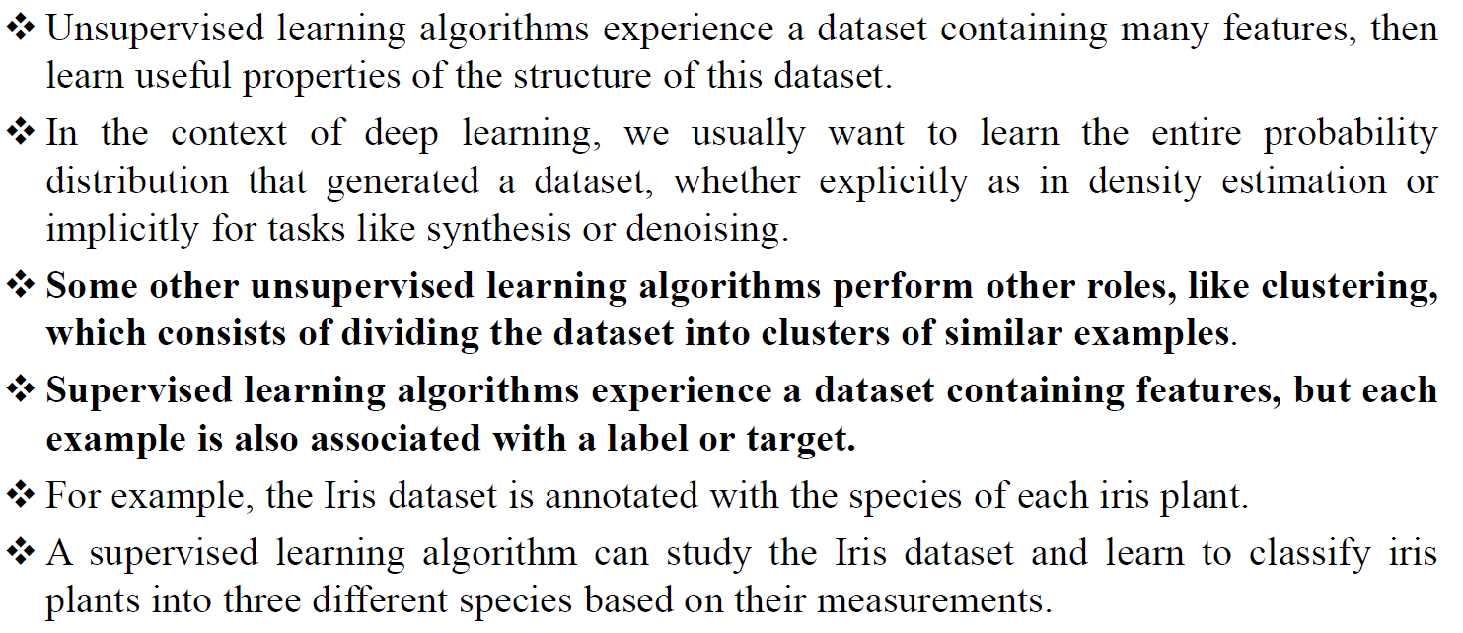

Slide 17
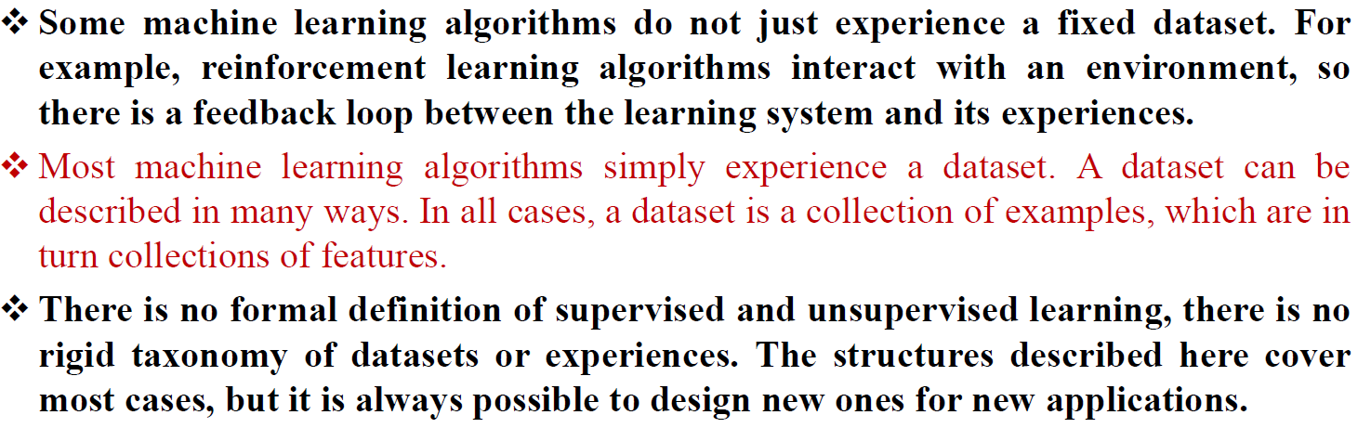

Slide 18
Capacity, Overfitting & Underfitting

Slide 19


The ability to perform well on previously unobserved inputs is called generalization.
There are two types of error measures in ML
Training Error | Test / Generaralization Error
error measure on the training set called the training error | error measure on the test set called the test error,
Train the model by reducing training error | reduce this test error
NOTE:- The relation between training and test error is that the expected training error of a randomly selected model is equal to the expected test error of that model.
How can we affect performance on the test set when we get to observe only the training set?
Ans:- statistical learning theory
The train and test data are generated by a probability distribution over datasets called the data generating process.
As per i.i.d. assumptions we assume that the examples in each dataset are independent from each other, and that the train set and test set are identically distributed, drawn from the same probability distribution as each other.
The same distribution is then used to generate every train example and every test example. We call that shared underlying distribution the data generating distribution, denoted pdata.

Slide 20
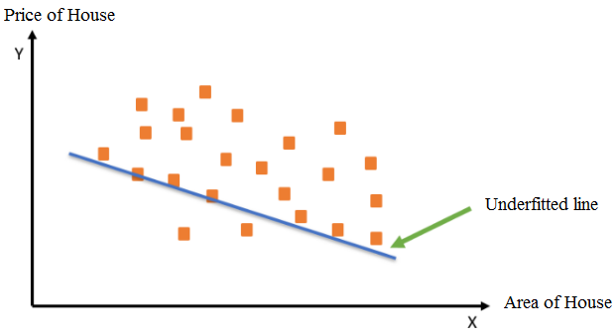
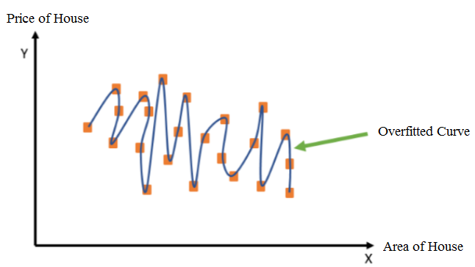
The factors determining how well a machine learning algorithm will perform are its ability to:
1. Make the training error small.
2. Make the gap between training and test error small.
These two factors correspond to the two central challenges in machine learning: underfitting and overfitting.
Underfitting | Overfitting
In underfitting, the machine learning model is not able to capture the underlying trend of the data. | Overfitting refers to a scenario when the model tries to cover all the data points present in the given dataset. As a result, the model starts caching noise and inaccurate values present in the dataset and then reduces the efficiency and accuracy of the model

Slide 21
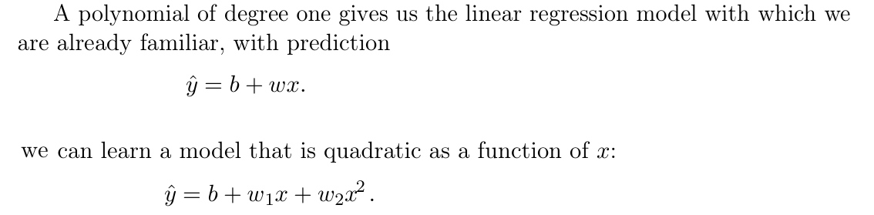
We can control whether a model is more likely to overfit or underfit by altering its capacity.
Model’s capacity is its ability to fit a wide variety of functions.
NOTE:-
Models with low capacity may struggle to fit the training set.
Models with high capacity can overfit by memorizing properties of the training set that do not serve them well test set
One way to control the capacity of a learning algorithm is by choosing its hypothesis space, the set of functions that the learning algorithm is allowed to select as being the solution
For example, the linear regression algorithm has the set of all linear functions of its input as its hypothesis space.
The linear function is unable to capture the curvature in the true underlying problem, so it underfits.
To increase the capacity of the model for linear regression, we include polynomials, rather than just linear functions, in its hypothesis space.

Slide 22
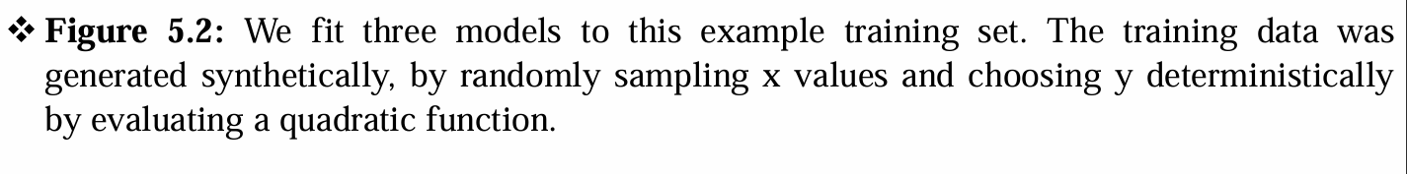
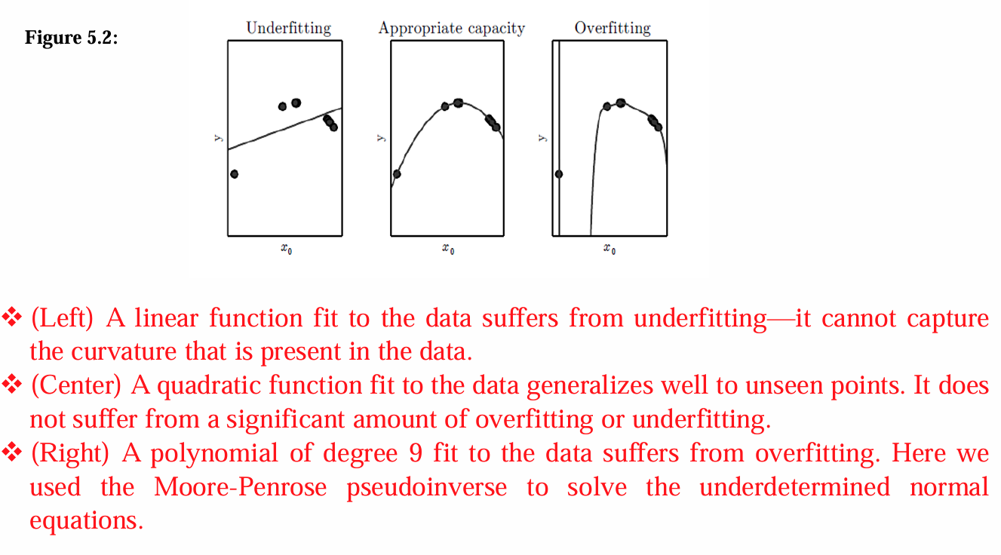
Models with insufficient capacity are unable to solve complex tasks (underfit). Models with high capacity can solve complex tasks, but when their capacity is higher than needed to solve the present task they may overfit.

Slide 23
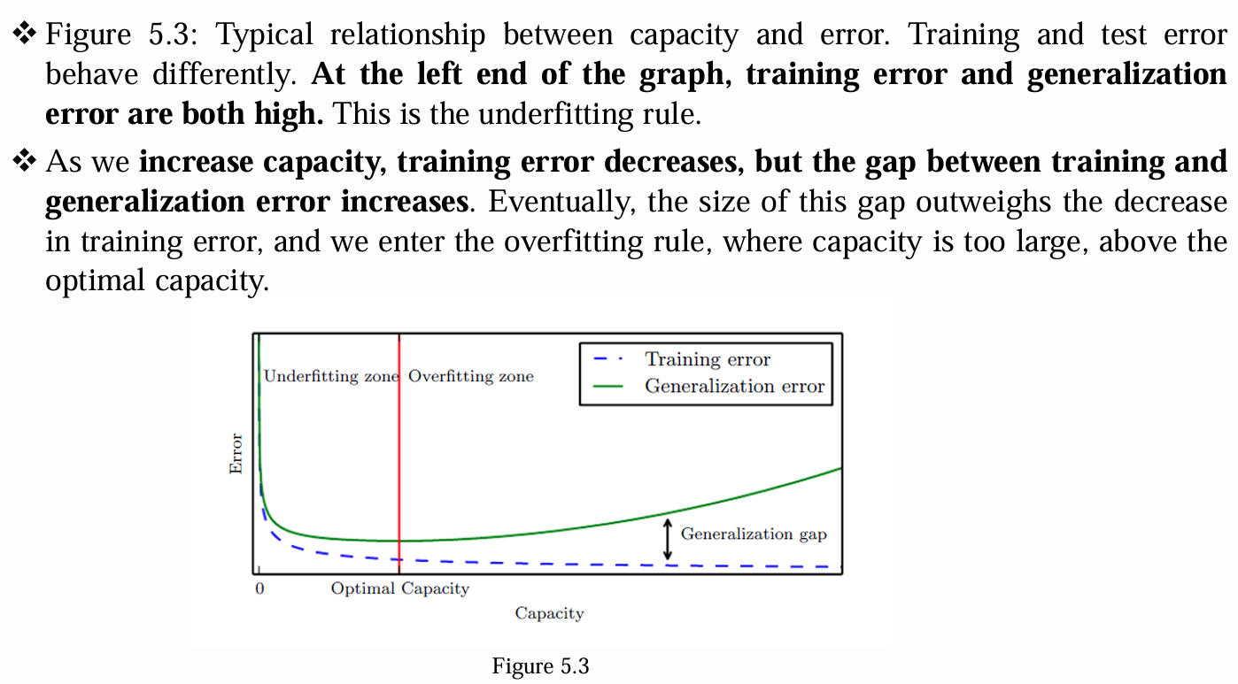
Relation between Capacity and Generalization Error

Slide 24
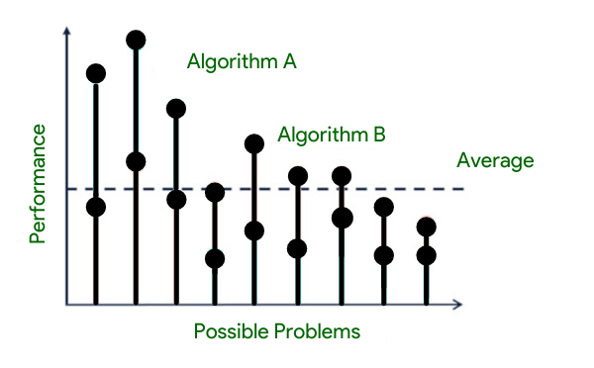
The No Free Lunch Theorem
There are two No Free Lunch (NFL) theorems in general: one for machine learning and one for search and optimization. These two theorems are connected and are frequently combined into a single general postulate (the folklore theorem).
According to the “No Free Lunch” theory, there is no one model that works best for every situation. | According to the “No Free Lunch” theorem, all optimization methods perform equally well when averaged over all optimization tasks without re-sampling.

Slide 25
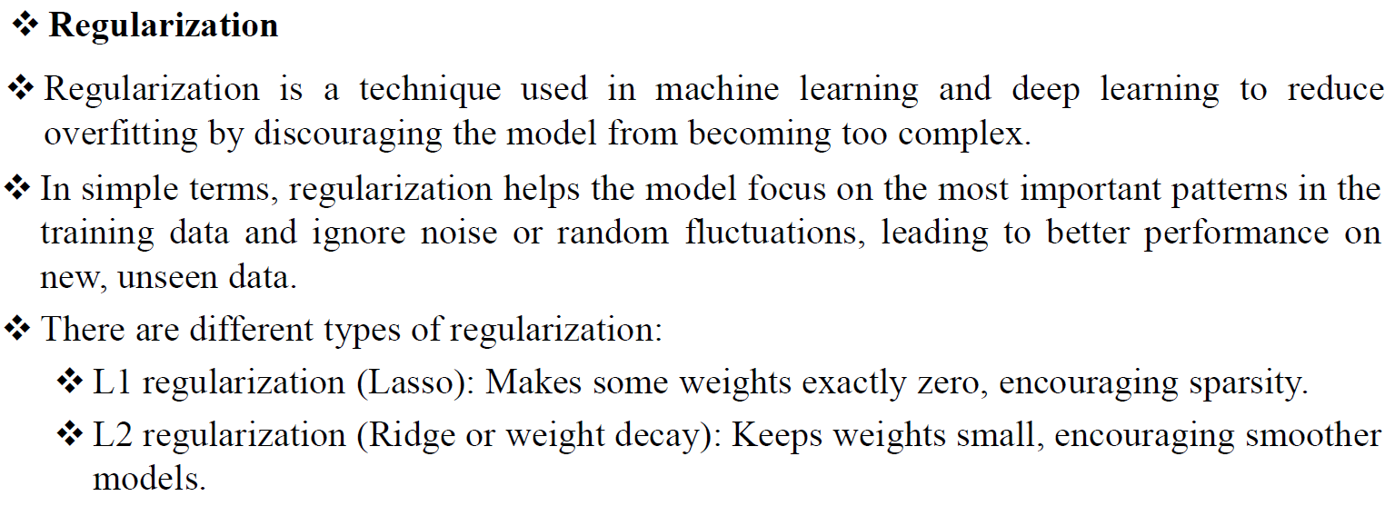
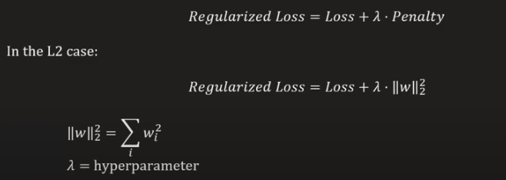
Regularization
 | Regularization helps prevent overfitting by penalizing large weights. So that while training model doesnot memorize the things instead it lears form data. The hyperparameter λ determines the trade-off between fitting the training data and keeping the model simple.

Slide 26
Hyperparameters & Validation sets

Slide 27
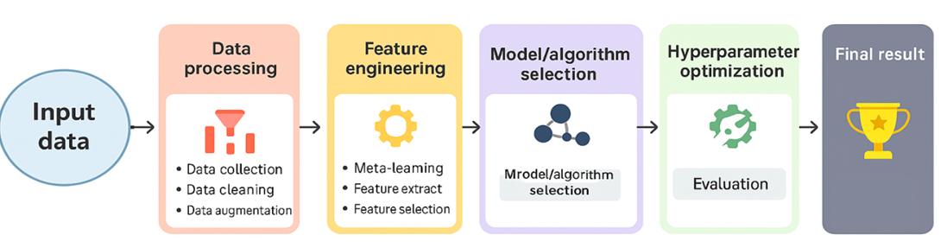
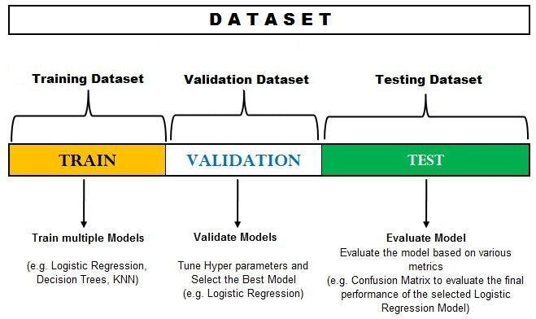
Dividing our data into three separate sets is a crucial step in machine learning.
This approach ensures that our model doesn’t become overly specialized (overfitted) to the training data, allowing it to perform well on unseen data.

Slide 28
In machine learning, hyperparameters are settings that are configured before the training process begins, controlling how the model learns. They are external to the model itself and are not learned during training, unlike model parameters.
Finding the right hyperparameter values is crucial for model performance. This process is called hyperparameter tuning or optimization, and it aims to find the best configuration of hyperparameters for a specific task.
Various techniques like grid search, random search, or Bayesian optimization are used to find optimal hyperparameters.
parameters are internal model values learned from data during training (like weights in a neural network), These parameters are tunable and can directly affect model prediction. Ex:- Weights in neural networks Coefficients in linear regression | hyperparameters are external settings that control the learning process itself, chosen before training (like the learning rate). These hyperparameters are tunable and can directly affect how well a model trains. Ex:- Learning Rate Number of Epochs Momentum Regularization constant Number of branches in a decision tree Number of clusters in a clustering algorithm (like k-means)

Slide 29
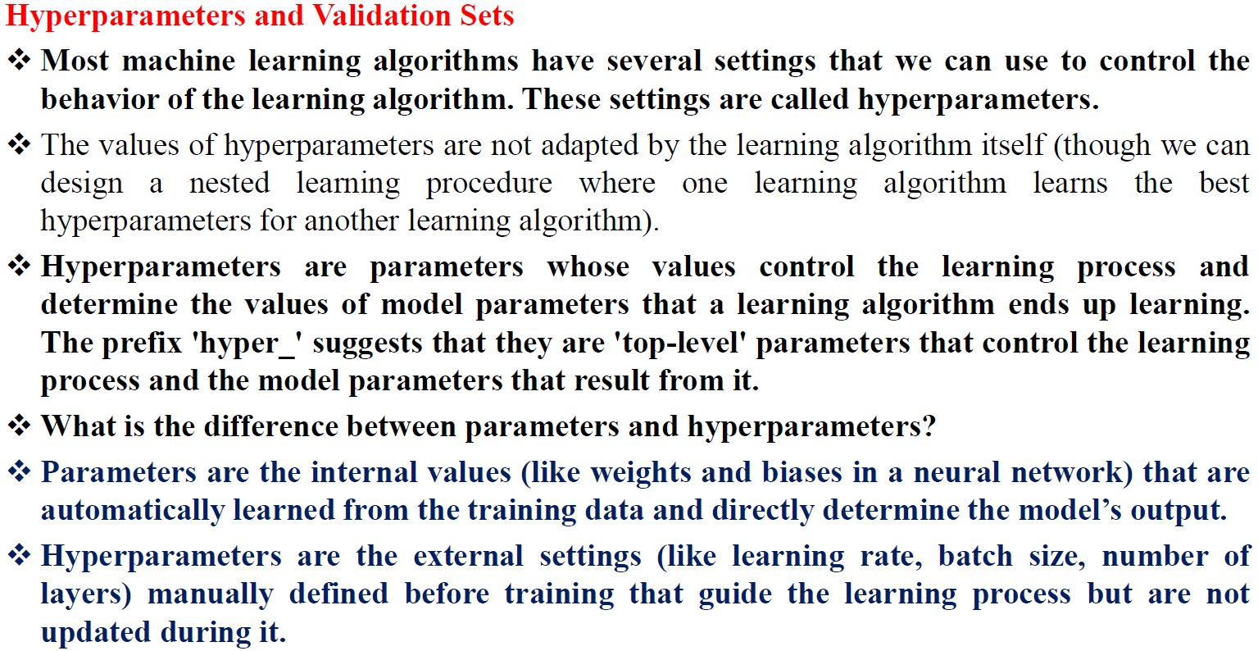

Slide 30
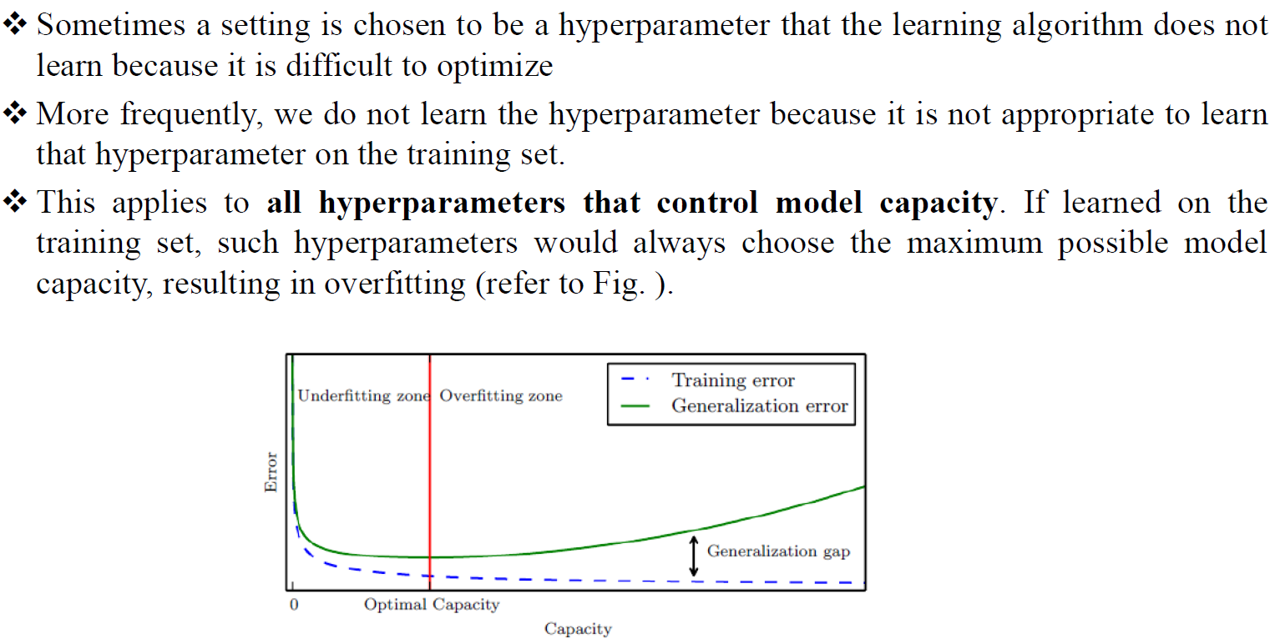

Slide 31
In the polynomial regression there is a single hyperparameter: the degree of the polynomial, which acts as a capacity hyperparameter. The λ value used to control the strength of weight decay is another example of a hyperparameter.
Sometimes a setting is chosen to be a hyperparameter that the learning algorithm does not learn because it is difficult to optimize.If learned on the training set, such hyperparameters would always choose the maximum possible model capacity, resulting in overfitting.
To solve this problem, we need a validation set of examples that the training algorithm does not observe.
Example:-
If 8000 records are in training set
And cross validation is given as 5
Then 8000/5 = 1600
So 1600 records from training set are copied into the validation set.

Slide 32
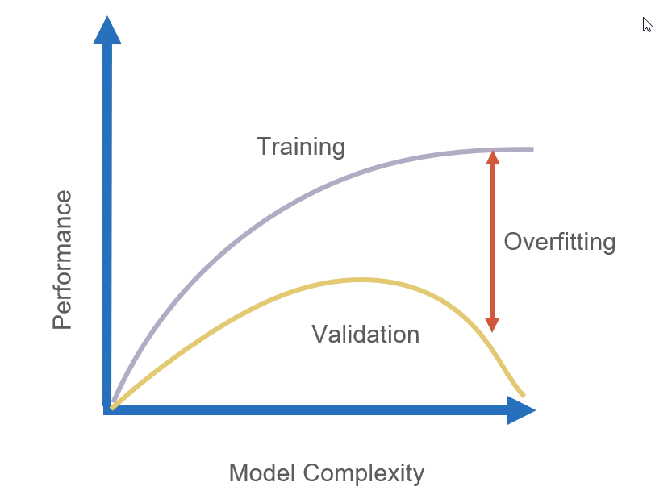
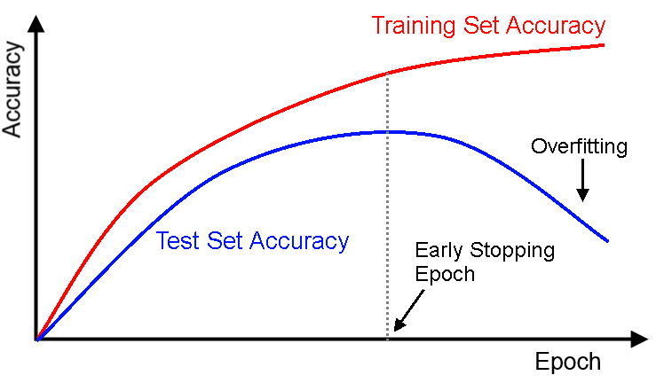
Problem:- The flaw with evaluating a predictive model on training data is that it doesn't tell you how well the model generalizes to new, unseen data.
Solution :- validation sets
While training the model we will compare the model on training set accuracy & validation set accuracy.
Initially both accuracies are same approximately , so training the model will be continued.
But there will be a point where the accuracy on the training data increases, while the accuracy on the test data starts to decrease, at that point you stop training the model.

Slide 33
Bias & Variance

Slide 34
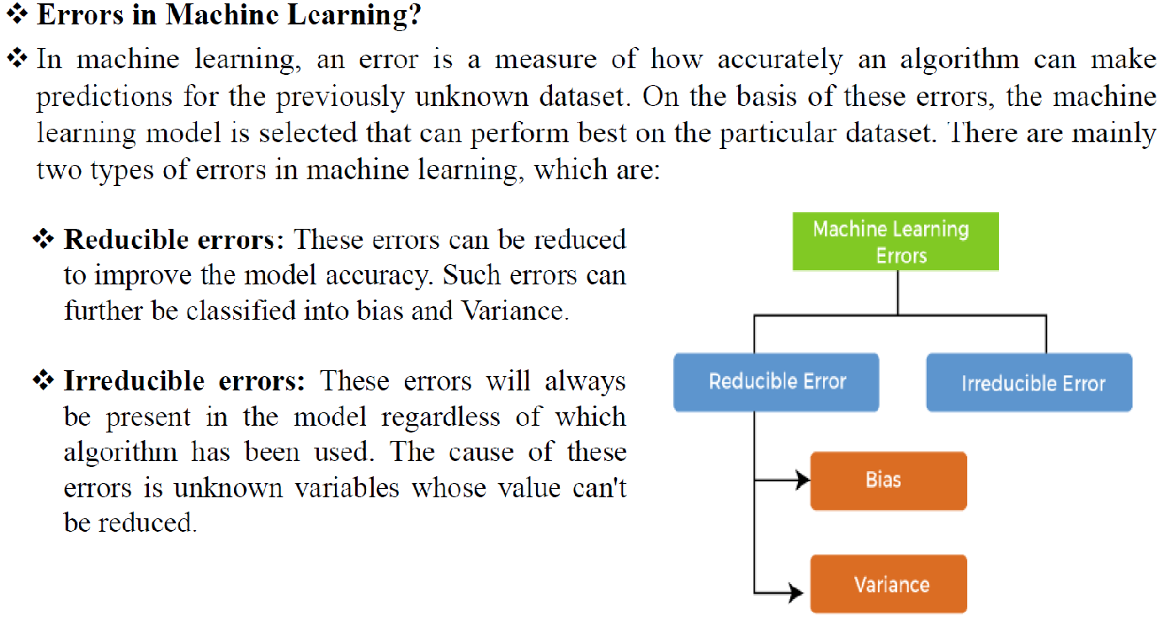

Slide 35
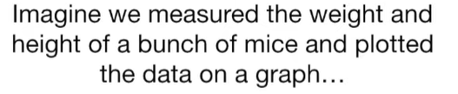
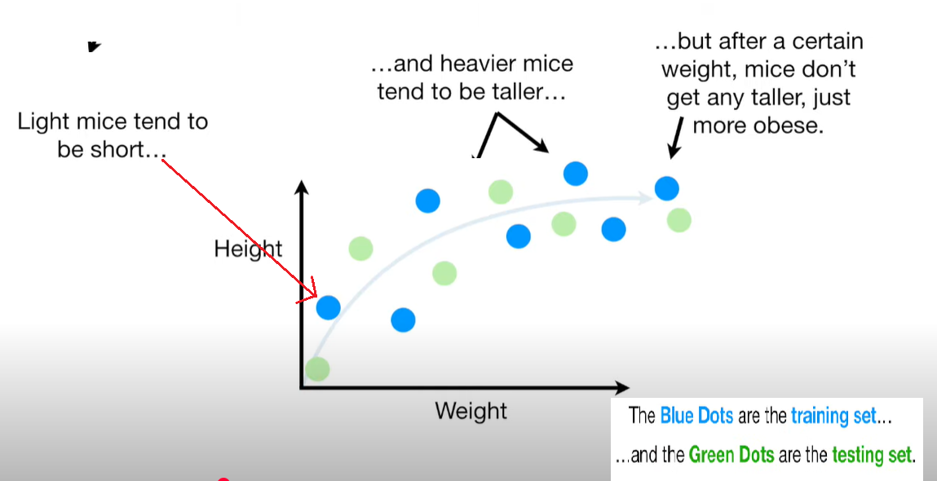
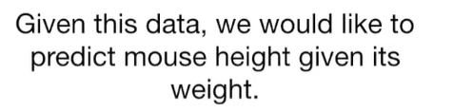
Scenario

Slide 36
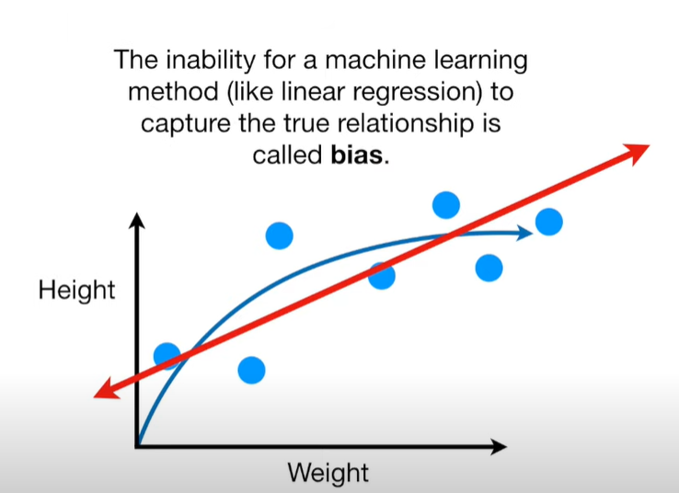
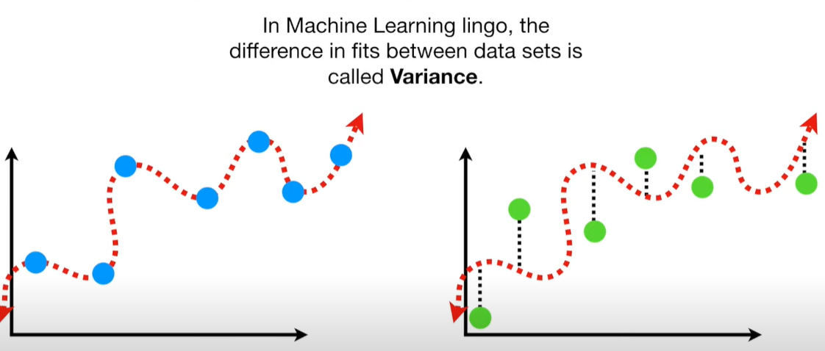
BIAS
VARIANCE

Slide 37
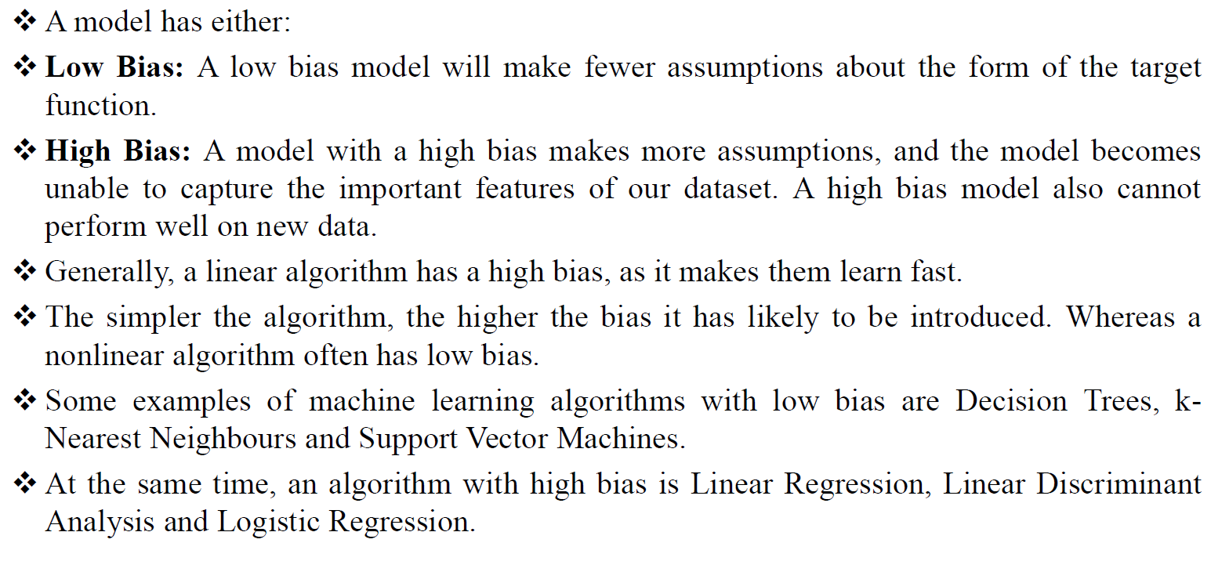

Slide 38
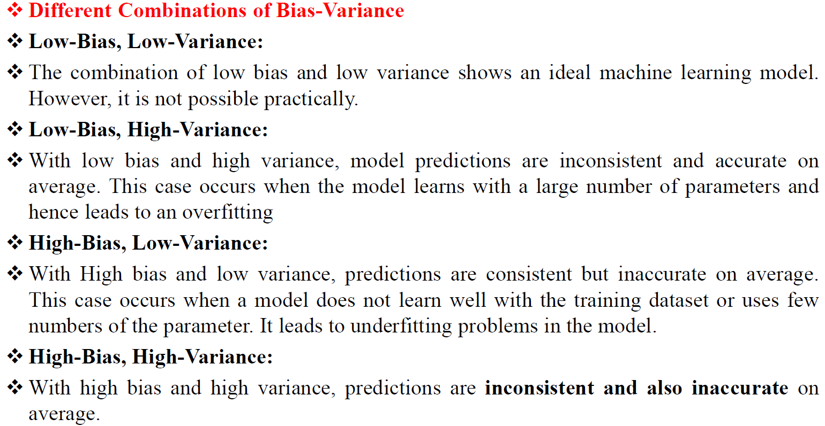

Slide 39
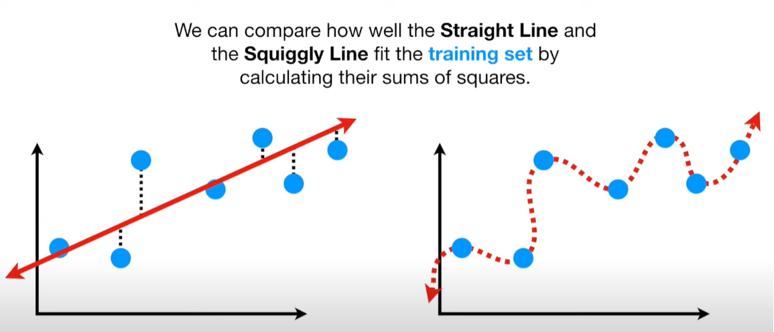
With Training set , squiggy line fit is best

Slide 40
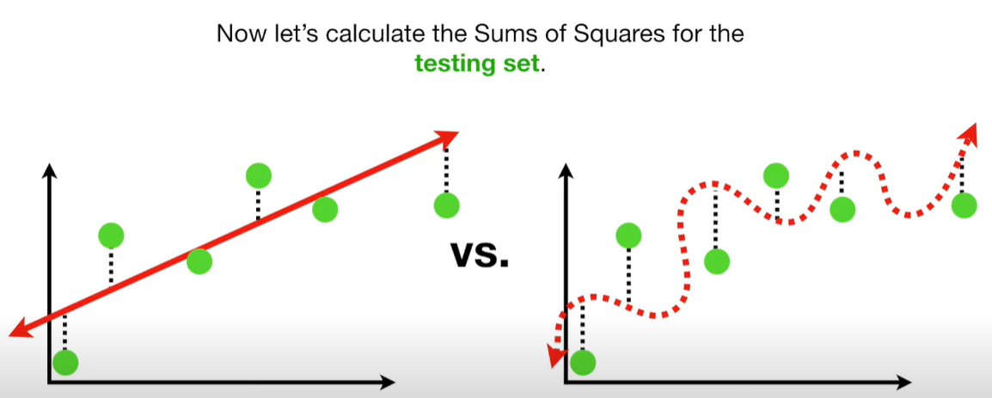
With testing set , Straight is the best fit

Slide 41
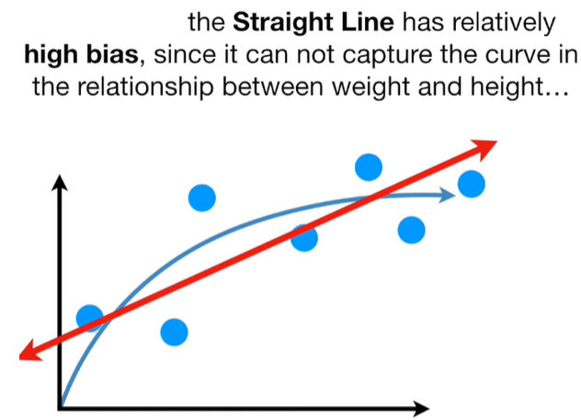
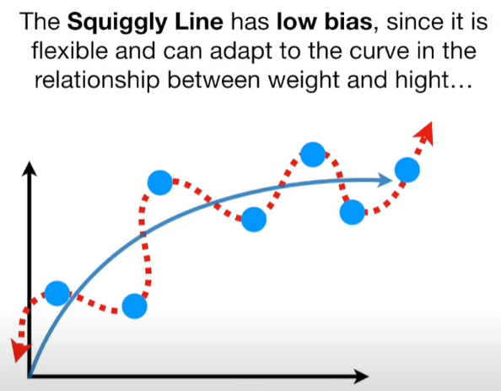
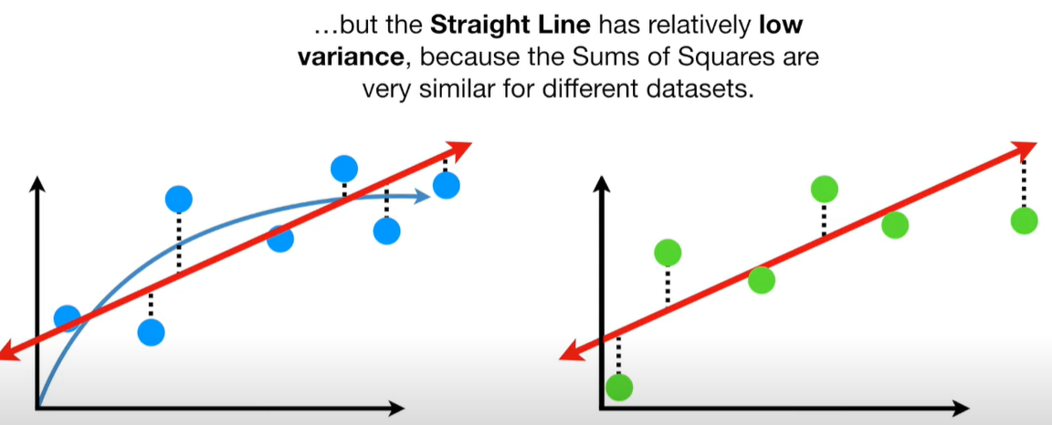
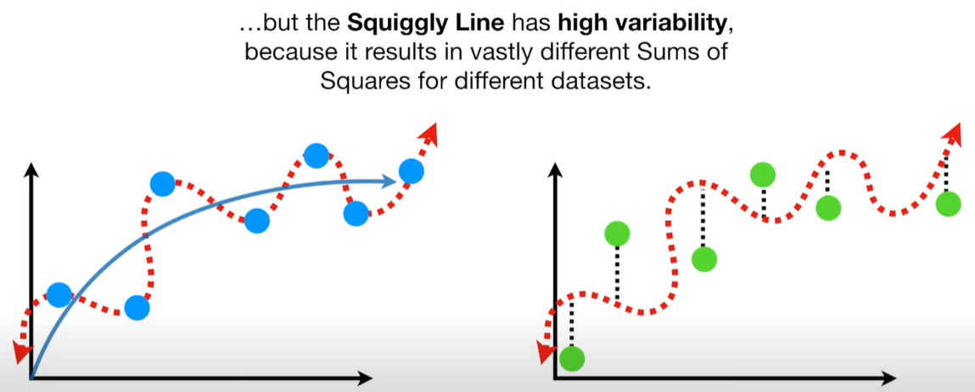
Stringht line gives consistently good predictions
Squiggly lines Sometimes predicts good sometimes bad

Slide 42
Maximum Likelihood Estimation

Slide 43
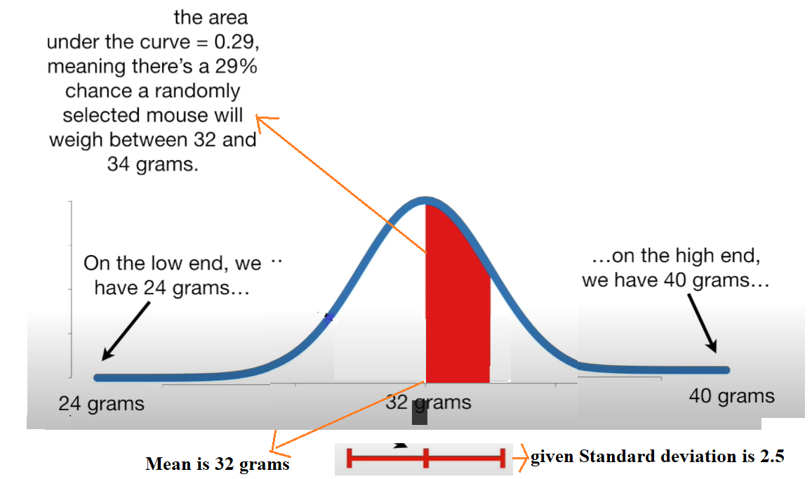
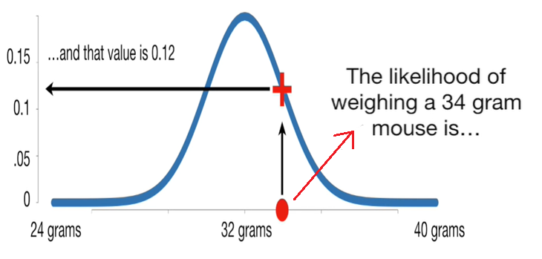
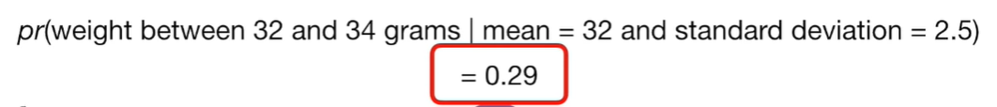
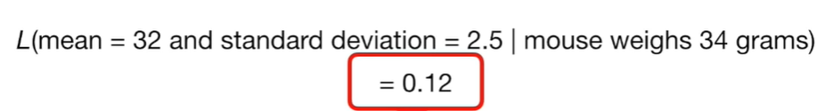
“In statistics probability is not likelihood”
Probability | Likelihood
Probability of a mouse weighing between 32 & 34 grams given standard deviation 2.5
Likelihood of a distribution with mean=32 & standard deviation =2.5 given weight of mouse is 34 grams is 0.12

Slide 44
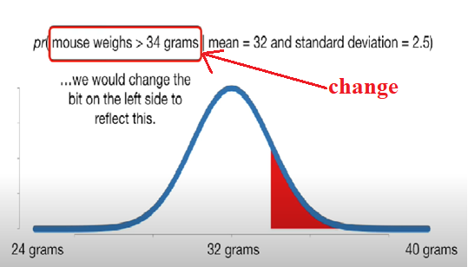
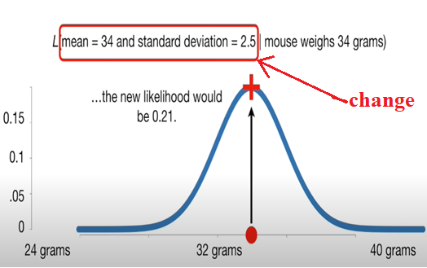
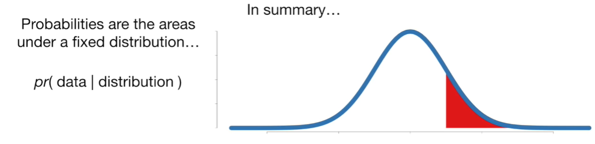
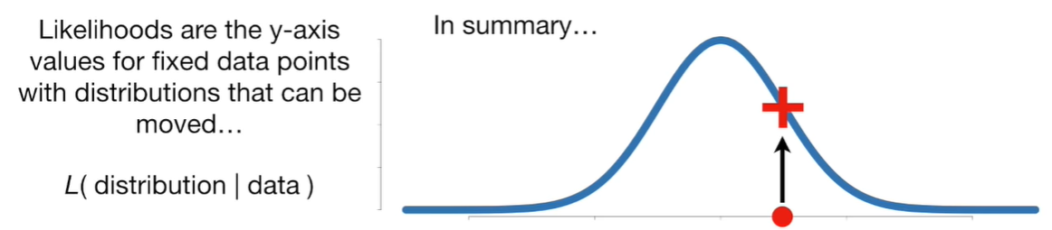
Probability | Likelihood
“Here distribution remains same”
“Here shape & location of distribution is modified”

Slide 45
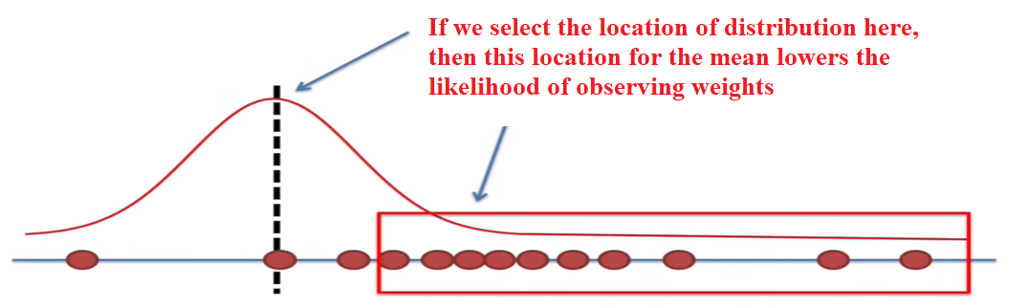
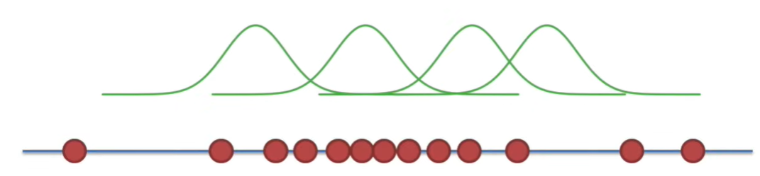
The goal of maximum likelihood is to find optimal way to fit a distribution to the data .
There are lots of types of distributions to different types of data .
Reason:- Fitting a distribution to the data , makes the thing easier & more general – it applies every experiment of same type.
So to maximise the likelihood , change the location of distribution & find out for which location the mean is maximum

Slide 46
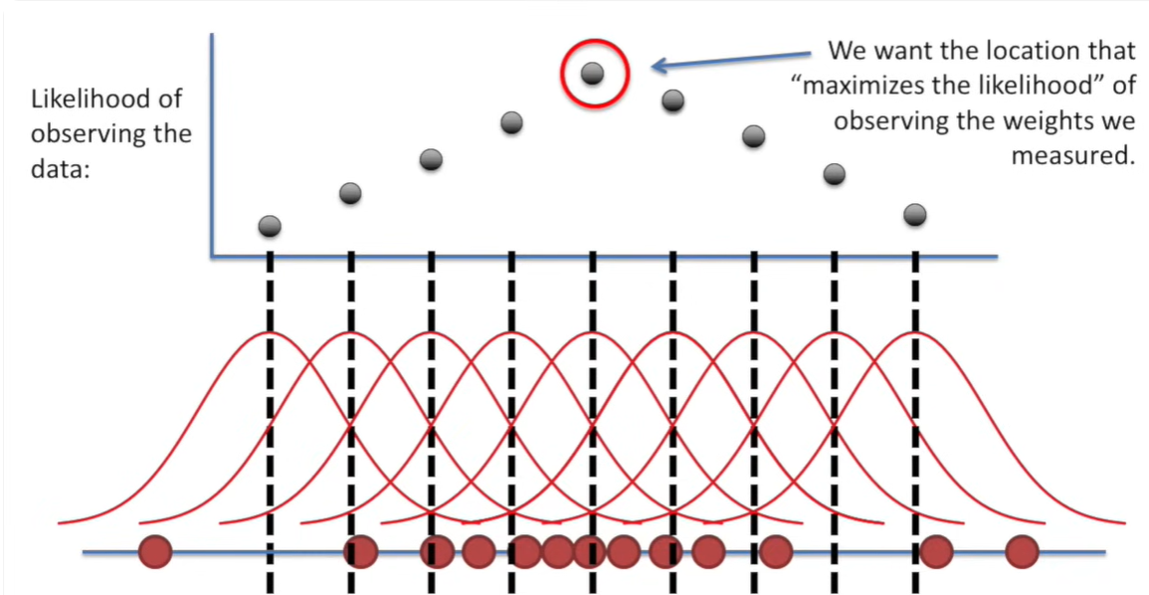

Slide 47
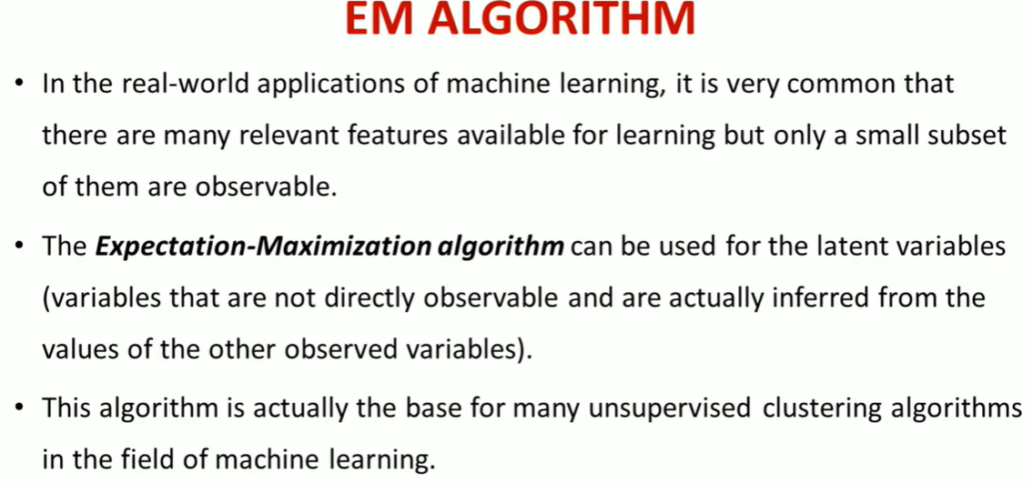
The Expectation-Maximization (EM) algorithm is a method used to perform Maximum Likelihood Estimation (MLE) when the data is incomplete, has missing values, or contains latent (hidden) variables.

Slide 48



Slide 49



Slide 50
Bayesien Statistics

Slide 51
Frequentist and Bayesian are two schools of thought in probability theory.
Frequentist Approach | Bayesian Approach
The frequentist approach is based on the idea of probability as the long-term frequency of an event in repeated trials. In this approach, statistical inference is based on the likelihood of observing the data given a null hypothesis, assuming that the null hypothesis is true. The null hypothesis is usually a statement about the population parameter of interest, such as the mean or the proportion. The frequentist approach uses methods such as hypothesis testing and confidence intervals to assess the evidence against the null hypothesis. Frequentist methods rely heavily on hypothesis testing, where the null hypothesis is tested against an alternative hypothesis. Frequentist methods tend to require larger sample sizes to obtain reliable results Frequentist methods focus on estimating the probability of observing the data given the null hypothesis | Bayesian approach is based on the concept of probability as a degree of belief in an event or hypothesis. In this approach, prior knowledge or beliefs about the population parameter of interest are combined with the likelihood of the data given the parameter to obtain the posterior distribution of the parameter. The posterior distribution summarizes the updated knowledge or beliefs about the parameter after observing the data. Bayesian methods use techniques such as Bayes’ theorem and Markov chain Monte Carlo (MCMC) simulation to obtain the posterior distribution. Bayesian inference involves model comparison using the Bayes factor or posterior probabilities. Bayesian methods can often be used with smaller samples. Bayesian methods focus on estimating the posterior distribution of the parameter of interest.

Slide 52

θ represents the true parameter value being estimated
X is the parameter that best explains the phenomenon
In statistics, alpha (α) and beta (β) are crucial values in hypothesis testing, representing the probabilities of
incorrect decisions. Alpha is the probability of a Type I error (false positive), while beta is the probability of a Type II error
(false negative). Balancing these errors is essential in experimental design.
Alpha (α):
Also known as the significance level, alpha is the probability of rejecting the null hypothesis when it is actually true.
It's a pre-set value (e.g., 0.05) that defines the threshold for statistical significance.
A smaller alpha reduces the chance of a Type I error but can increase the risk of a Type II error.
Beta (β):
Beta is the probability of failing to reject the null hypothesis when it is false.
It's the probability of a Type II error.
A smaller beta indicates a higher probability of detecting a true effect (higher statistical power).

Slide 53

Relationship and Balancing:
Alpha and beta have an inverse relationship: reducing one typically increases the other.
Increasing the sample size can decrease both alpha and beta, but may also increase costs.
Choosing appropriate alpha and beta values depends on the consequences of each error type. In medical research, for instance, a false negative (high beta) might be more serious than a false positive (high alpha).
Example:
In a clinical trial, alpha (0.05) is the probability of wrongly concluding that a new drug is effective when it's not.
Beta (0.20) is the probability of wrongly concluding that the new drug is not effective when it actually is.
The power of the test (1 - β) is the probability of correctly identifying a true effect.
By understanding and carefully managing alpha and beta, researchers can design experiments that are more likely to produce reliable and meaningful results.

Slide 54

The Bayesian perspective is based on Bayes’ Theorem, a formula that takes into account the probability of an event based on prior knowledge. The formula is shown below, where:
P(A): the probability of A occurring
P(B): the probability of B occurring
P(A|B): the probability of A given event B
P(B|A): the probability of B given event A
Pr(A|B): the posterior, the probability of the parameters given the data.
The probability of a hypothesis is calculated and deemed true using prior opinions and knowledge as new data is readily available. This is called prior probability, which is concluded before the project starts.
This prior probability is then converted into a posterior probability, the belief once the project has started.
Prior + Likelihood = Posterior

Slide 55

In Bayesian statistics, we start with an initial belief about the distribution of parameters (prior distribution), which we update based on observed data to obtain a revised distribution (posterior distribution).
▪ Prior Distribution (P(θ)): The prior distribution represents our initial belief about the parameters of interest before observing any data.
▪ Posterior Distribution (P(θ∣X)): The posterior distribution reflects our updated belief about the parameters after observing the data X. It combines the prior distribution with the likelihood of the observed data. Again, it is represented as a PDF.
Scenario
A pharmaceutical company is testing a new drug and wants to estimate the probability that it is effective.

Slide 57
Stochastic Gradient Descent

Slide 58


As in neural networks, the main goal is to predict the output which is similar to the actual output. In order to check the difference between actual output (y) and the predicted output( y^), we calculate the cost function.
Cost Function is a function that measures the performance of a model for any given data, the error between predicted values and expected values and presents it in the form of a single real number.
Gradient Descent helps optimize machine learning models by minimizing the cost function.
Gradient Descent is of three types-
Stochastic Gradient Descent.
Batch Gradient Descent.
Mini-Batch Gradient Descent.

Slide 59


When our cost function is not convex?
if we apply normal gradient descent to non-convex function. So, We found a local minimum instead of a global minimum. And this is not the correct one, because this is not the global minimum.
To solve this local minimum problem in the neural networks, the Stochastic Gradient Descent is used.
In Stochastic Gradient Descent, we take the row one by one. So we take one row, run a neural network and based on the cost function, we adjust the weight. Then we move to the second row, run the neural network, based on the cost function, we update the weight. This process repeats for all other rows. So, in stochastic, basically, we are adjusting the weights after every single row rather than doing everything together and then adjusting weights.

Slide 60
Stochastic Gradient Descent
Stochastic Gradient Descent (SGD) is a widely used optimization algorithm in deep learning.
It iteratively updates the model's parameters by using a subset of the training data (mini-batch) to calculate the gradient of the loss function.
This approach introduces randomness and is computationally more efficient than traditional gradient descent, especially for large datasets.
1. Gradient Descent and its Variants:
Gradient Descent:
This algorithm minimizes a loss function by iteratively moving in the direction of the steepest descent (negative gradient) of the function. It calculates the gradient using the entire training dataset, which can be computationally expensive for large datasets.
Stochastic Gradient Descent (SGD):
SGD addresses the computational burden of gradient descent by using a single data point (or a small mini-batch) to compute the gradient in each iteration. This introduces randomness, which can help the algorithm escape local minima and converge faster.
Mini-batch Gradient Descent:
This is a variation of SGD where a small batch of training examples is used to calculate the gradient, striking a balance between computational efficiency and stability.

Slide 61
2. How SGD Works in Deep Learning:
SGD is the foundation for many optimization algorithms used in deep learning frameworks.
It's an iterative process where:
A mini-batch of training data is sampled.
The model makes predictions based on the current parameters.
The loss function is calculated.
The gradient of the loss function is computed with respect to the model's parameters.
The parameters are updated using a learning rate and the calculated gradient.
This process is repeated until convergence or a predefined number of iterations is reached.
3. Advantages of SGD:
Computational Efficiency:
SGD is faster than traditional gradient descent for large datasets, as it doesn't require processing the entire dataset in each iteration.
Escaping Local Minima:
The randomness introduced by SGD can help the algorithm escape local minima in the loss function landscape, potentially leading to better solutions.

Slide 62
4. Challenges of SGD:
Noisy Gradients:
The stochastic nature of SGD can lead to noisy gradients, which might cause the algorithm to oscillate around the optimal solution or slow down convergence.
Learning Rate Tuning:
Choosing the right learning rate is crucial for SGD. A small learning rate can lead to slow convergence, while a large learning rate can cause oscillations and instability.
5. Variants of SGD:
Many advanced optimization algorithms used in deep learning, such as Adam, Adagrad, and RMSprop, are based on SGD and incorporate techniques to address its challenges and improve performance.
In summary, SGD is a powerful and widely used optimization algorithm in deep learning. Its efficiency and ability to escape local minima make it suitable for training complex models on large datasets.

Slide 63
Steps to Build an ML Algorithm

Slide 64
Steps to Build an ML Algorithm
Define the problem
Prepare and split data
Choose model architecture
Define loss function
Select optimizer
Train model
Evaluate and tune
Deploy
In deep learning, building an ML algorithm means creating a model that learns patterns from data using neural networks.
Here’s a step-by-step explanation

Slide 65
1. Define the Problem
What are we trying to solve?
Examples:
Predicting house prices
Recognizing handwritten digits (like MNIST)
Classifying images (cat vs dog)
This helps define:
Input features (X)
Output labels (Y)
2. Prepare the Data
Steps:
Collect data
Clean it (remove missing or noisy values)
Normalize or scale features
Split into:
Training Set (used to learn)
Validation Set (tune hyperparameters)
Test Set (evaluate performance)

Slide 66
3. Choose a Model Architecture
In deep learning, we build neural networks:
Input Layer -receives raw data
Hidden Layers – extract patterns (with activation functions like ReLU, Sigmoid)
Output Layer – gives predictions (e.g., softmax for classification)
👉 Example:For image classification:
Input (pixels) → Dense → ReLU → Dense → Softmax
4. Define Loss Function
The model needs a way to measure how wrong it is.
Common loss functions:
MSE (Mean Squared Error) :for regression
Cross-Entropy Loss : for classification
5. Choose Optimizer
An optimizer updates weights to reduce the loss.
Popular choices:
SGD (Stochastic Gradient Descent)
Adam (adaptive learning rate)
It uses backpropagation to compute gradients and update weights.

Slide 67
6. Train the Model
The model "learns" by adjusting weights using training data.
Each epoch is one full pass through the training set.
Batch size = number of samples processed before updating weights.
Training loop:
for epoch in range(num_epochs):
forward pass → compute loss → backpropagation → update weights
7. Evaluate the Model
Use validation or test data to check:
Accuracy
Precision / Recall
Loss curve
If it's underfitting or overfitting, go back and:
Change model structure
Add regularization (Dropout, L2)
Collect more data

Slide 68
8. Tune Hyperparameters
Adjust things like:
Learning rate
Number of layers
Batch size
Activation functions
Use grid search or random search for tuning.
9. Deploy the Model
Once the model performs well, save it and deploy it to production:
Convert to a format (like .h5 or .pt)
Integrate with a web/mobile app
Monitor performance in real-world usage
Example Tools
Task | Tools
Building model | TensorFlow, PyTorch, Keras
Data handling | Pandas, NumPy
Visualization | Matplotlib, TensorBoard
Deployment | Flask, FastAPI, ONNX

Slide 69
Challenges and Motivation to Deep Learning

Slide 70
Challenges and Motivation to Deep Learning
Motivation for Deep Learning
Traditional Machine Learning (ML) methods—like decision trees or SVMs—work well for small datasets and low-dimensional features. But they struggle with:
High-dimensional inputs (e.g., images, audio)
Complex patterns
Unstructured data (text, video, speech)
Deep Learning (DL) is inspired by the human brain and uses neural networks with many layers to automatically learn features from raw data.
Motivation | Explanation
Automatic Feature Learning | No manual feature engineering needed (unlike ML)
Scalable with Data | More data → better performance (DL thrives on big data)
Works on Unstructured Data | Handles images, text, audio natively
High Accuracy | Often beats traditional models in tasks like vision & NLP
Representation Learning | Learns multiple levels of abstraction

Slide 71
11.Challenges in Deep Learning
1. Data Requirements
Deep learning needs huge amounts of labeled data
Hard to apply on small datasets without overfitting
2. Computational Cost
Training requires GPUs or TPUs
Energy-intensive (costly for large-scale training)
3. Interpretability
Neural networks are black boxes
Difficult to understand or explain how predictions are made
4. Overfitting
Too many parameters can cause models to memorize the data
Needs regularization (dropout, early stopping, etc.)

Slide 72
5. Hyperparameter Tuning
Learning rate, layers, batch size... all need tuning
Finding the best configuration is non-trivial
6. Training Instability
Gradient vanishing/exploding in deep networks
Requires careful initialization and normalization (e.g., BatchNorm)
7. Ethical Concerns
Bias in training data = biased predictions
Deepfakes, surveillance, misinformation are concerns

